Slide 1
CS252 Project Proposal
Perceptron-Based BP
Shengmin Liu, Jiaqi Huang

Slide 2
Branch Predictor
Importance of Branch Prediction:
High performance cost per error for modern processors
Errors concentrated on hard branches that limits further gain
Growing relevance in modern workloads
Influence on other part of computer architecture

Slide 3
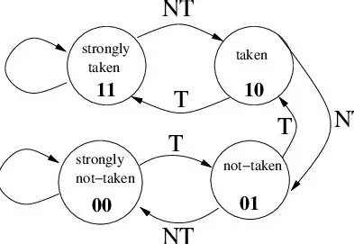
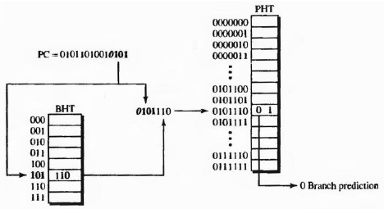
Branch Prediction
Static Prediction
Dynamic predictors
  2-bit predictor
  2-level predictor
  Hybrid predictor

Slide 4
Modern Predictors - TAGE(Tagge Geometry History Length)
Uses multiple prediction tables indexed by different global history lengths and selects the longest-history entry whose tag matches the branch, reducing aliasing and adapting to diverse branch behaviors.
Index all tables
Check Tags and select the one with longest history
Counter - taken or not taken
Updates counters, usefulness, history
Most modern BPs use TAGE as the base.

Slide 5
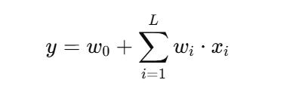
State-of-the-art solutions: Perceptron
TAGE: Find a memorized pattern for this branch at the right history length
Learn a weighted combination of past outcomes
This predicts based on a constant branch bias wo and correlation strength with past predictions wi

Slide 6
Implementation and Analysis of Branch Predictor
Performance simulation through Gem5
Hardware implementation through Chisel and Chipyard
Metrics:
Gem5: Hit/Miss Rate(MPKI), CPI, workload sensitivity, etc
Chipyard: RTL functionality, Timing, Area, Power, etc

Slide 7
Benchmarks
We want to investigate the performance of branch predictor on different branch workloads:
Regular: for sanity and functionality check
Loop-heavy, nested control
Data-dependent, irregular branches

